Slide 1


Split Array With Same Average
CSA0695- DESIGN ANALYSIS AND ALGORITHMS FOR OPEN ADDRESSING TECHNIQUES
GUIDED BY
DR.R. Dhanalakshmi
DONE BY
D. Megha Syam Naidu
(192210507)

Slide 2


Understanding the Problem Statement
We are given an array of integers, 'nums'. Our task is to determine if we can divide this array into two non-empty subarrays, 'A' and 'B', such that the average of 'A' is equal to the average of 'B'.
Input
Output
An integer array 'nums'.
True if a split is possible, false otherwise.
Example
For 'nums' = [1,2,3,4,5,6,7,8], we can split it into [1,4,5,8] and [2,3,6,7], both with an average of 4.5.

Slide 3


Abstraction
We can try all possible combinations of dividing the array into two subarrays. For each combination, we can calculate the average of both subarrays and check if they are equal. This approach is computationally expensive, especially for larger arrays.
1
Generate Subarrays
Generate all possible combinations of dividing the array into two subarrays.
2
Calculate Averages
For each combination, calculate the average of the two subarrays.
3
Compare Averages
Check if the averages of the two subarrays are equal.

Slide 4

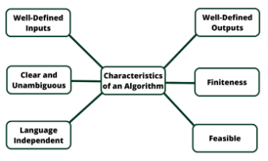
Introduction
The task at hand is to determine whether an integer array nums can be partitioned into two non-empty subsets, A and B, such that the average of both subsets is the same. To achieve this, the sum of the elements in A and B must be proportional to their sizes relative to the entire array. In other words, if the average of the entire array is avg_total = sum(nums) / len(nums), both A and B should satisfy average(A) = average(B) = avg_total.
Subset Sum Proportionality: The sum of elements in A should be proportional to the size of A relative to the whole array. If the total sum of the array is S = sum(nums) and its size is n = len(nums), then for any subset A of size k, the sum of the elements of A should be
sum(A) = k * avg_total = (k * S) / n.
Divisibility Condition: For the above equation to hold, k * S must be divisible by n. This means that not all subsets are valid candidates; only those where this divisibility condition is satisfied can be conside

Slide 5


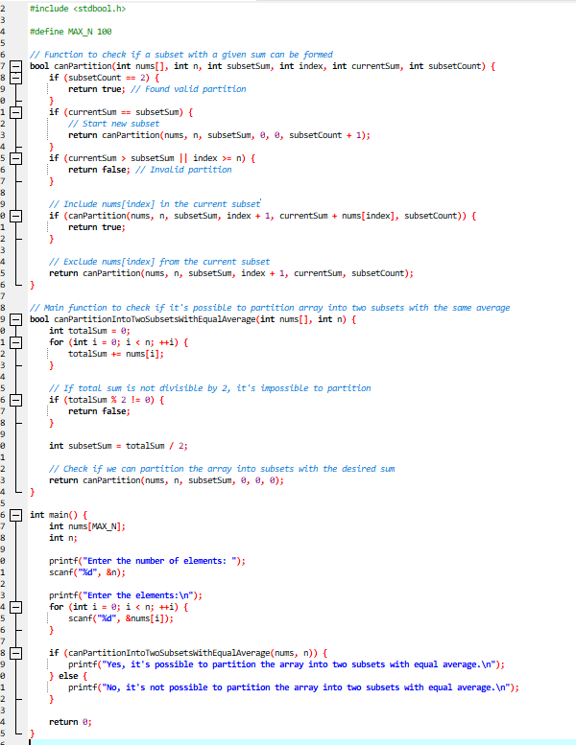
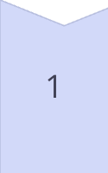
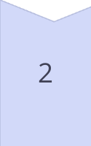
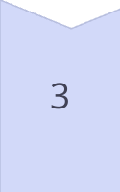
Optimizing the Dynamic Programming Solution
The dynamic programming solution can be optimized by calculating the total sum of the array and the desired sum for each subarray. This allows us to efficiently check for the existence of two subarrays with equal averages.
Calculate Total Sum
Calculate the total sum of the elements in the array 'nums'.
Calculate Target Sum
Calculate the target sum for each subarray, which is half the total sum.
Populate DP Table
Populate the dynamic programming table to check for the existence of subarrays with the target sum.

Slide 6

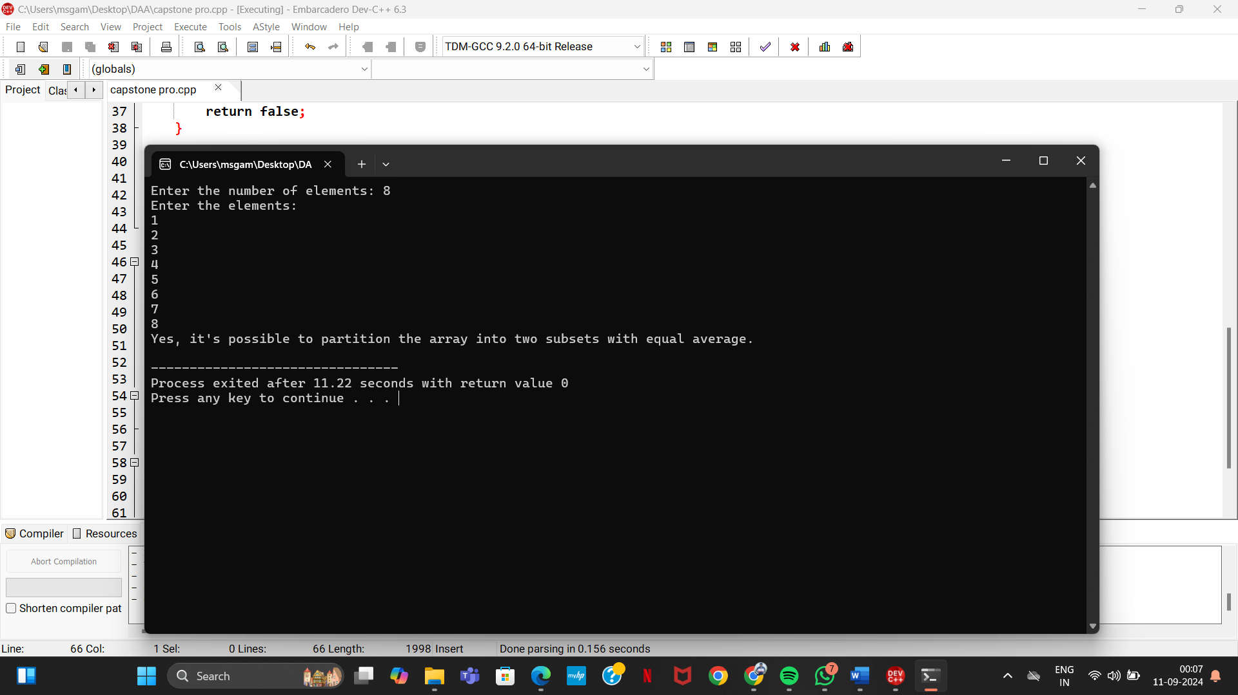
Handling Edge Cases
It is essential to consider edge cases. If the array is empty or has only one element, it cannot be split into two non-empty subarrays. Similarly, if the total sum of the array is odd, it is impossible to achieve equal averages for the subarrays.
1
Empty Array
2
Single Element Array
If the array is empty, return false.
If the array has only one element, return false.
3
Odd Total Sum
If the sum of the array is odd, return false.

Slide 7

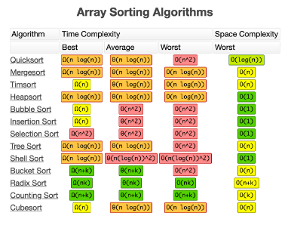


Time and Space Complexity Analysis
The time complexity of the optimized dynamic programming solution is O(n * sum), where 'n' is the length of the array and 'sum' is the total sum of the elements. The space complexity is also O(n * sum) due to the dynamic programming table.
Time Complexity
Space Complexity
O(n * sum)
O(n * sum)

Slide 8
Conclusion and Future scope
Dynamic programming provides an efficient solution to determine if an array can be split into two subarrays with equal averages. Understanding edge cases is crucial for ensuring correct handling of all possible inputs. This problem highlights the power of dynamic programming in solving complex problems.
Future scope
The problem involves partitioning an integer array into two non-empty subarrays with equal averages. By analyzing the sum and length properties, and using dynamic programming to search for valid subsets, we can determine whether the array can be split in the required manner.
This problem has applications in areas such as resource allocation, data partitioning, and load balancing.

